Slide 1

IS739 INFORMATION SYSTEMS IN ORGANIZATIONAL DESIGN AND APPLIED SYSTEM THINKING New forms and multi-unit organizations: building on the fundamentals
Doğan DOĞANAY

Slide 2
Outline
Introduction
Multi-organization: multiple units of analysis
The multi-organization step-by-step approach
Joint Venture
Merger
Strategic Alliance or Partnership
Summary

Slide 3

Introduction
Up to now, a single unit of analysis
Now, multiple units of analysis (joint venture, the merger, the strategic alliance or partnership)
# of mergers and acquisitions has increased
Thus, organizational designs of multi-unit organizations have become even more important than earlier.
Problem is how to combine and create a new organizational unit based on new or existing units.

Slide 4
Multi-organization: multiple units of analysis
The basics of organizational design still hold and should be applied when managing multi-organizations. Why?
First, multi-organizations are not a new phenomenon and most of them fail; but, if they manage well the change process associated with joint venture, mergers and alliances to build and integrated organization, they can be successful
Second, multi-organizations are organizations in their own right, where each has its own strategy, environment, configuration, distributes organization, people, leadership, climate, coordination, control, information systems and incentives.

Slide 5
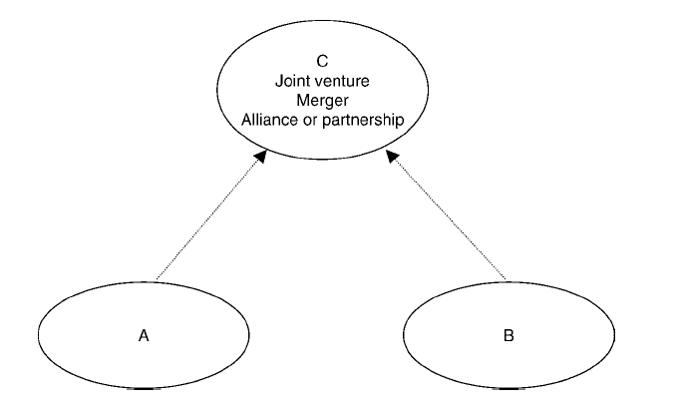
Multi-organization: multiple units of analysis
You can analyze a joint venture, merger or alliance in the same way as you do in a single organization. The tools are same. Only, you should think more than one unit of analysis.
Here think three organizations:
The two parents:
A and B form the C

Slide 6
Multi-organization: multiple units of analysis
Sometimes A and B form C to be similar in design to the two parents – similar in goals, strategy, people, leadership, and so on. But many times A and B form C to create something quite different from themselves.
What should we do?
Basically;
First, examine focal organization C, then examine the parents A and B. Finally, examine the relationship between C and its parent organizations A and B

Slide 7
The multi-organization step-by-step approach
Firstly, the main steps to analyze a multi-organization:
Analyze C as a seperate organization by applying single organization step-by-step approach
Anlayze A seperately using the step-by-step approach
Analyze B seperately using the step-by-step approach
Analyzing each as a separate units of analysis will allow you to see the points of fit and misfit and identify possibilities for change within each unit in design, especially for C.

Slide 8
The multi-organization step-by-step approach
The next step is to examine the relationships between A and C, and then B and C.
Examine the relations between A and C to understand:
What Goals does A have for C? And vice versa.
What results, outcomes and outputs does A expect from C?
What Resources-leadership, personnel and financing- does A give to C?
What Policies and limitations does A place upon C?
What Aggrements and contracts does C have with A?

Slide 9
The multi-organization step-by-step approach
Repeat step 1 to examine the relations between B and C as above.
The next steps are to do a higher level of misfit analysis and possible changes.
Take the analyses above for A and C. Make two lists side by side – one for A and one for C. Then compare A and C on each of the dimensions from your analysis: goals, strategy, environment, etc. Many of these entries will be different, perhaps almost all. But focus on the different ones that will hinder C in realizing its goals; these are significant misfits.

Slide 10
The multi-organization step-by-step approach
Develop a list of changes in the relationship between A and C that will improve these misfits and facilitate C in the accomplishment of its goals.
Repeat these steps for B and C.
Do a comparison of A and C with B and C. If these relationships are quite different, then there is likely to be conflict between A and B, which will make it difficult for C as it pursues its work. C then needs to address these issues and make a determination of whether to live with them or work with A and B for a solution.

Slide 11

Joint venture
The joint venture C is an organization that is given resources and supported by its parents, A and B, but C is largely independent of A and B.
First step-as discussed above- in analyzing a joint venture is to do separate analyses of A, B, C and then turn to their relations.
The joint venture C should plan its organizational design and assess its misfits as the venture evolves.

Slide 12
Joint venture
C should be assessed as an independent unit of analysis. Then it should look at the goals that A and B have for the joint venture and the resources they are supplying.
Can C realize its goals? Are there sufficient resources?
If there are misfits here, then C, must decide to live with them, or approach the parents to obtain a resolution.

Slide 13

Merger
The merger is the result that A and B becoming a new organization, C.
Hovewer, C cannot be understood (alone) without an assessment of where it came from. The people, climate, coordination, and control systems, and many other organizational design components of A and B will be imported into C and will influence C’s organizational design in significant ways.
Analysis of the C organization is prior to its formation and an assessment of the parents’ influence on C, can be very helpful.

Slide 14
Merger
To assess the design of the new, merged organization, you should first do separate step-by-step analyses of each of the three organizations, revealing possible misfits and ways to change them. Then turn to differences that create misfits after the merger.
Suggested approach is:
Make two lists side by side. Then compare each of the organizational design components: goals, strategy, environment, etc.

Slide 15
Merger
Focus on the differences, as these will create variation in the particular dimension for the merged organization. Assess if these differences are important and how they should be handled. Develop a list of changes in the relationship.
Look at the misfits for the new potential organization. Consider how they should be addressed.
Look at which quadrant the two companies are located in;
If the two units are in the same quadrant and both are well aligned with no misfits, a “simple” merger is possible. Then the action depends on which quadrant the two units are located in.

Slide 16
Merger
If two organizations that are not in the same quadrant there is an issue of where the merged company should be located. For a takeover, the smaller organization will have to adapt. For more equal organizations, use the goal, environment, and strategy analyses in step 1 to determine which quadrant to go to. That will also be the case when one or both companies have misfits.

Slide 17

Strategic alliance or partnership
Strategic aliance or partnership is planned collaboration among multiple firms for conducting business activity together for purposes of mutual benefits.
Alliances are contract-driven and arise in many different forms.
The assignment of people, leaders, infrastructure, and other organizational components of C are drawn from the parent organizations and typically remain there as the partnership operates. In this sense, an alliance is the opposite of a joint venture or a merger.

Slide 18
Strategic alliance or partnership
When forming a strategic alliance, begin with an analysis of the anticipated C organization, following the step-by-step approach. Next do the same for A and B, and any other parents that are a part of the alliance.
Then, move on to the higher-level misfits between the strategic alliance and the parent organizations. The analysis and resolution of the higher level misfits must be addressed for a successful strategic alliance or partnership.

Slide 19
Summary
Multi-organizations and multiple units of analysis
Multi-organizations with step-by-step approach
Joint venture,
Mergers,
Strategic Alliances

Slide 20
Thanks
Any comment?

